Slide 1
Optics-free Image Classification with Deep Metric Learning ____________________________
Prakhar Srivastava
University of Tartu
Supervised by:
Prof. Kallol Roy
University of Tartu, Estonia
Notes:
Hi everyone! My name is Prakhar Srivastava, and my thesis topic is Optics-free image classification with Deep metric learning. And my supervisor is Prof Kallol Roy

Slide 2


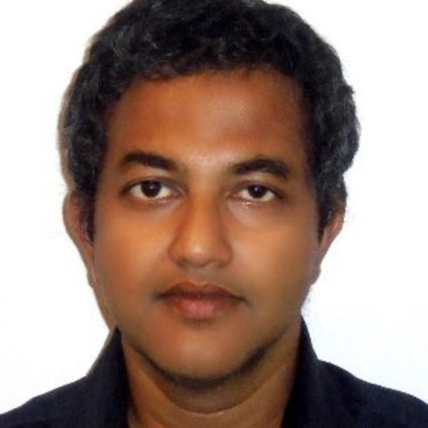


Collaborations
Kallol Roy
Rajesh Menon
Soren Nelson
Notes:
For this thesis, we worked in collaboration with the University of Utah research team. Basically, we have used the dataset provided by them to train our model

Slide 3
Content
Introduction
Camera fundamentals
Optics-free imaging
Image classification
Methods
Results
Conclusion and Future work
Notes:
The contents that I will be discussing are these.

Slide 4
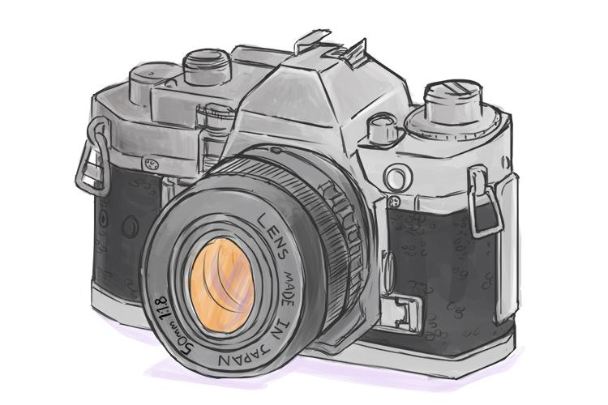
https://mammothmemory.net/physics/lenses/convex-lenses/convex-lens-uses-camera.html
Notes:
So here comes the camera, which is a part of my hobby as I love to click pictures of animals. That is why I choose that topic which is close to my hobby and can be useful in solving the real-world problems in optics.

Slide 5
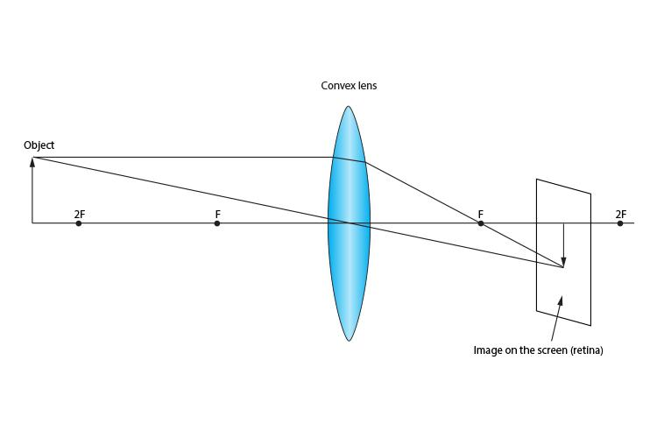
Image formation basics
https://mammothmemory.net/physics/lenses/convex-lenses/convex-lens-uses-camera.html
Notes:
In this image, as you see, shows how an image has been formed using a lens. The lens is placed in front of the object, and light that hits the lens through an object is captured on the screen

Slide 6
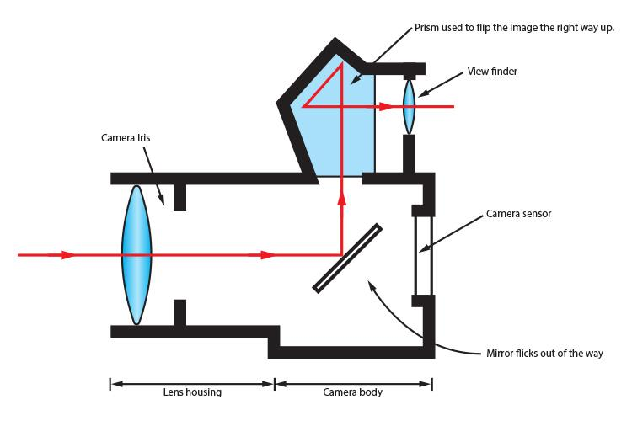
Camera fundamentals
https://mammothmemory.net/physics/lenses/convex-lenses/convex-lens-uses-camera.html
Notes:
The same method is followed by the conventional camera to capture images into the sensor. The only add-on that has been added to the picture is the viewfinder lens which is used to view the object before it been clicked. This camera is useful for normal photoshoots. But when it comes to the field like medical imaging or survance these aren't useful.

Slide 7
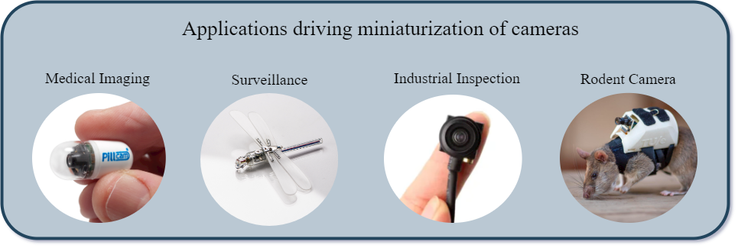
Need of miniaturization
https://www.outlookindia.com/website/story/india-news-iit-madras-and-rice-university-researchers-develop-algorithms-for-lensless-miniature-cameras/382684
Notes:
So here comes the need for miniature cameras.

Slide 8
Problem of miniaturization of lens
Getting light inside miniature lenses is difficult
Notes:
Cameras are getting smaller and smaller
All the optical equipments are difficult to fit-in into such a small space.

Slide 9
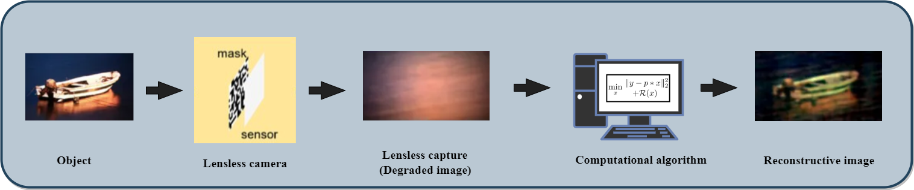
Lens replace with algorithm
https://medium.com/@bezzam/lensless-imaging-with-the-raspberry-pi-and-python-diffusercam-473e47662857
Notes:
So researcher came up with the solution of replacing the lens with the algorithm. Which can reconconstructive an optic-free image

Slide 10
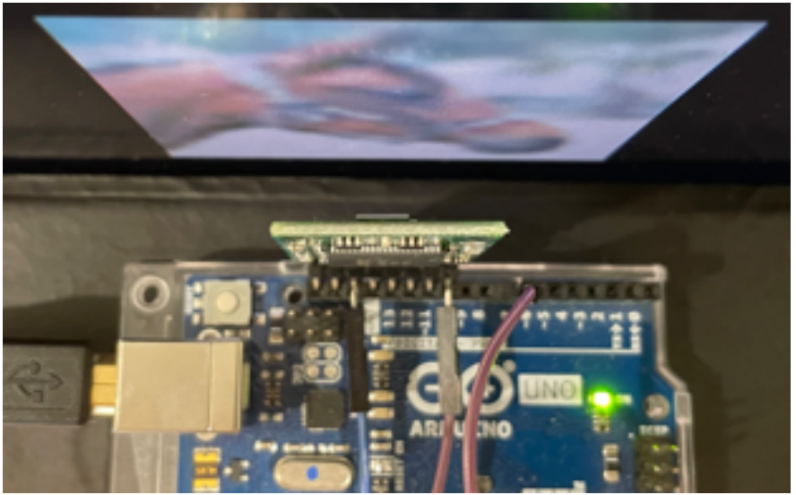
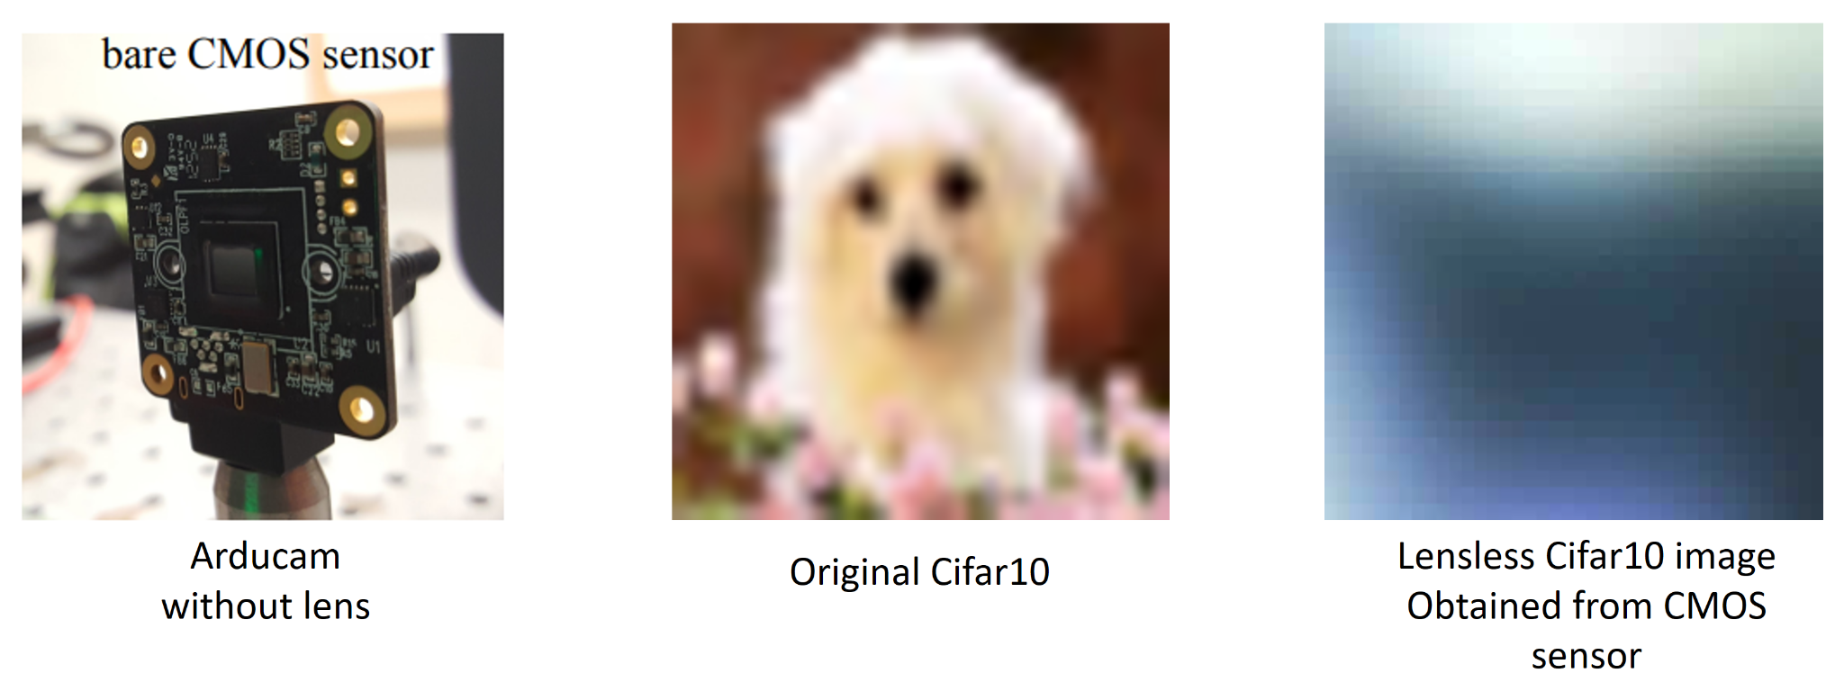
LCD
CMOS Sensor
Menon, Rajesh; Nelson, Soren (2021): Supplementary document for Bijective-constrained cycle-consistent deep-learning for optics-free imaging and classification - 5399506.pdf.
Notes:
This is what the setup looks like. Where original Cifar10 images are placed in front of the CMOS sensor

Slide 11
“ Deep Metric Learning ”

Slide 12
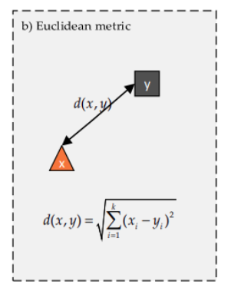
What is Metric Learning?
Metric learning is a technique that focuses on mapping similar data points close to each other in the embedding space, while mapping dissimilar data points far away from each other.
KAYA, M.; BİLGE, H.Ş. Deep Metric Learning: A Survey. Symmetry 2019, 11, 1066.

Slide 13
Feature is all you need
Metric is the essential feature for the model to learn
Notes:
Improve classification accuracy
Enhance feature extraction
Address data imbalance
And for our model, metric is the essential feature that helps it to learn

Slide 14
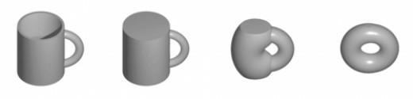
Metric invariance
ideal condition
Features stays invariant (constant)
https://math.stackexchange.com/questions/2258389/how-can-a-mug-and-a-torus-be-equivalent-if-the-mug-is-chiral
Notes:
1. Translation invariance: Since you are using lensless CIFAR-10 images as the anchor samples, it may be important to preserve translation invariance when selecting the positive and negative samples. This means that the positive and negative samples should be selected in a way that preserves the translation of the object in the image, since the lensless images may not have the same level of detail as the original images.
2. Class-specific invariance: Since your goal is to classify images in the CIFAR-10 dataset, it may be important to preserve class-specific invariance when selecting the positive and negative samples. This means that the positive samples should be images of the same class as the anchor sample, and the negative samples should be images of a different class. By preserving this invariant, you can help ensure that the learned distance metric is effective for distinguishing between different classes.
3. Scale invariance: Depending on the nature of the objects in the images, it may be important to preserve scale invariance when selecting the positive and negative samples. For example, if the objects are animals, then preserving scale invariance would mean selecting positive and negative samples that have similar sizes to the anchor sample.
4. Rotation invariance: Similarly, if the objects in the images have a specific orientation, it may be important to preserve rotation invariance when selecting the positive and negative samples. This means selecting samples that have similar orientations to the anchor sample.

Slide 15
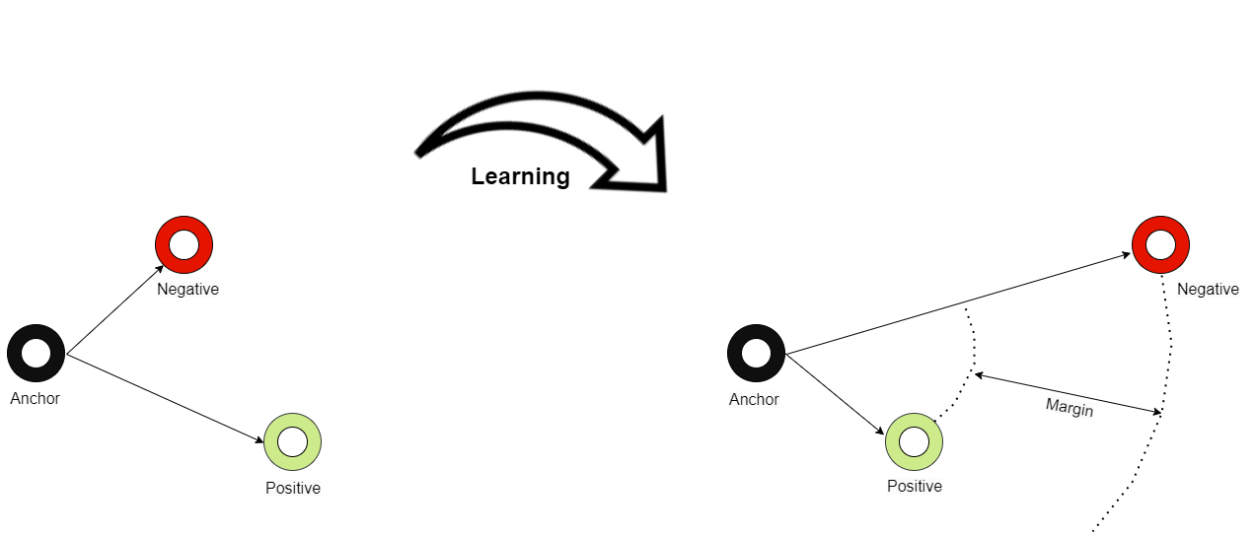
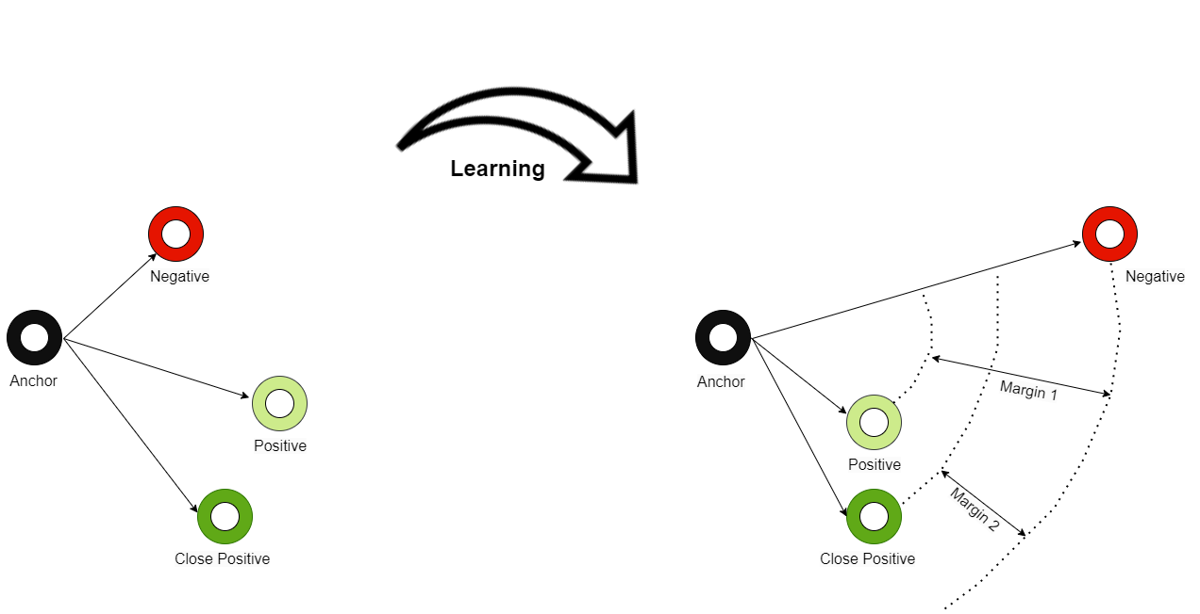
Loss functions
Triplet loss
Quadruplet loss

Slide 16
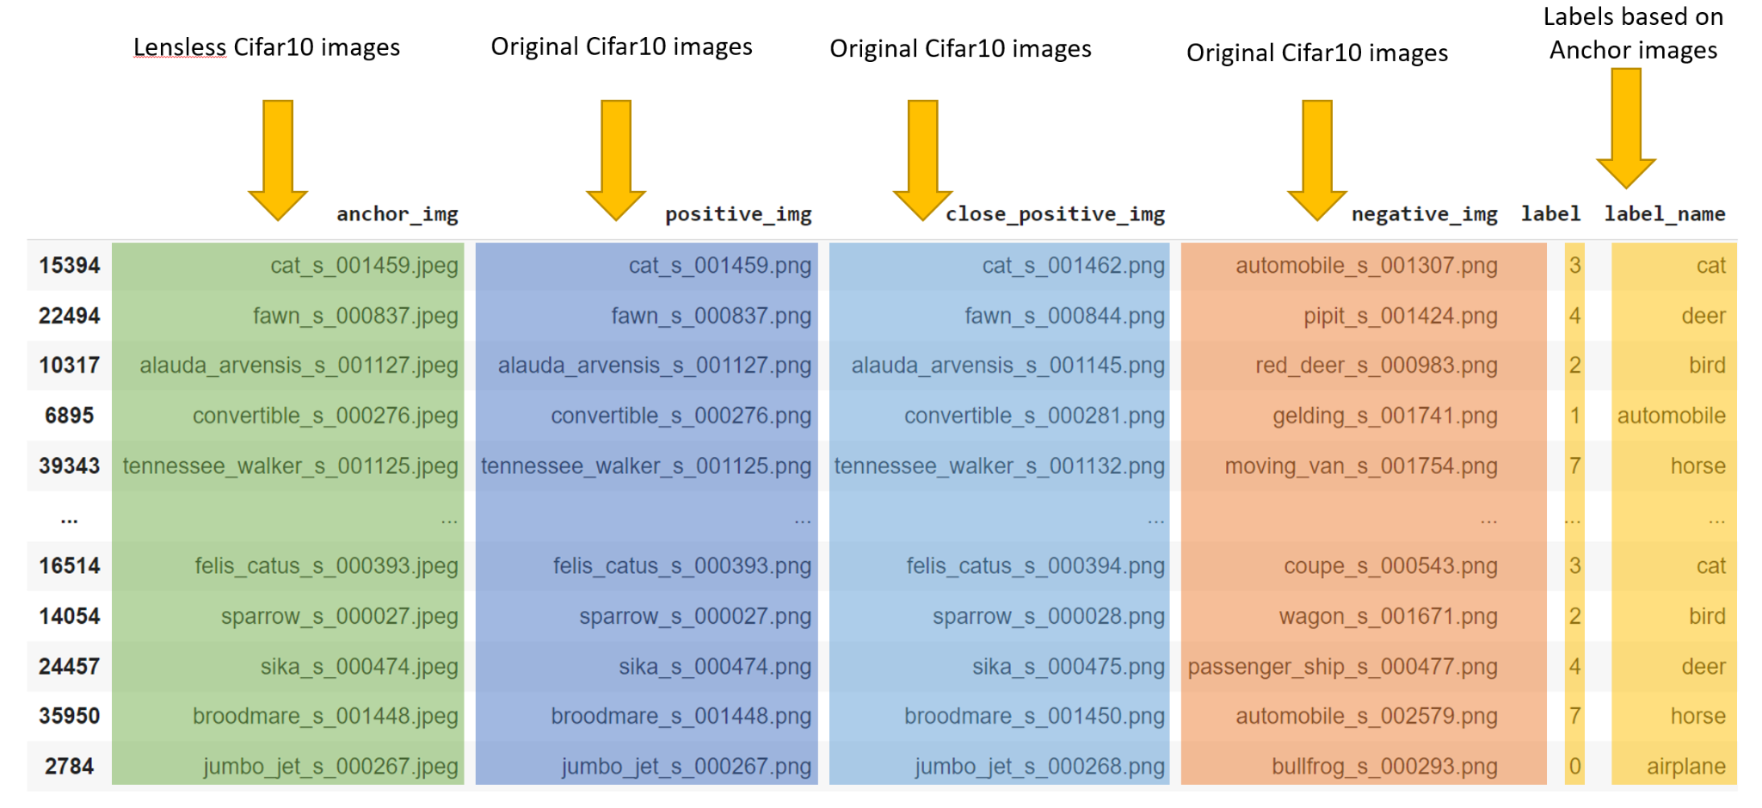
Building the dataset
Data loader

Slide 17
Model

Slide 18
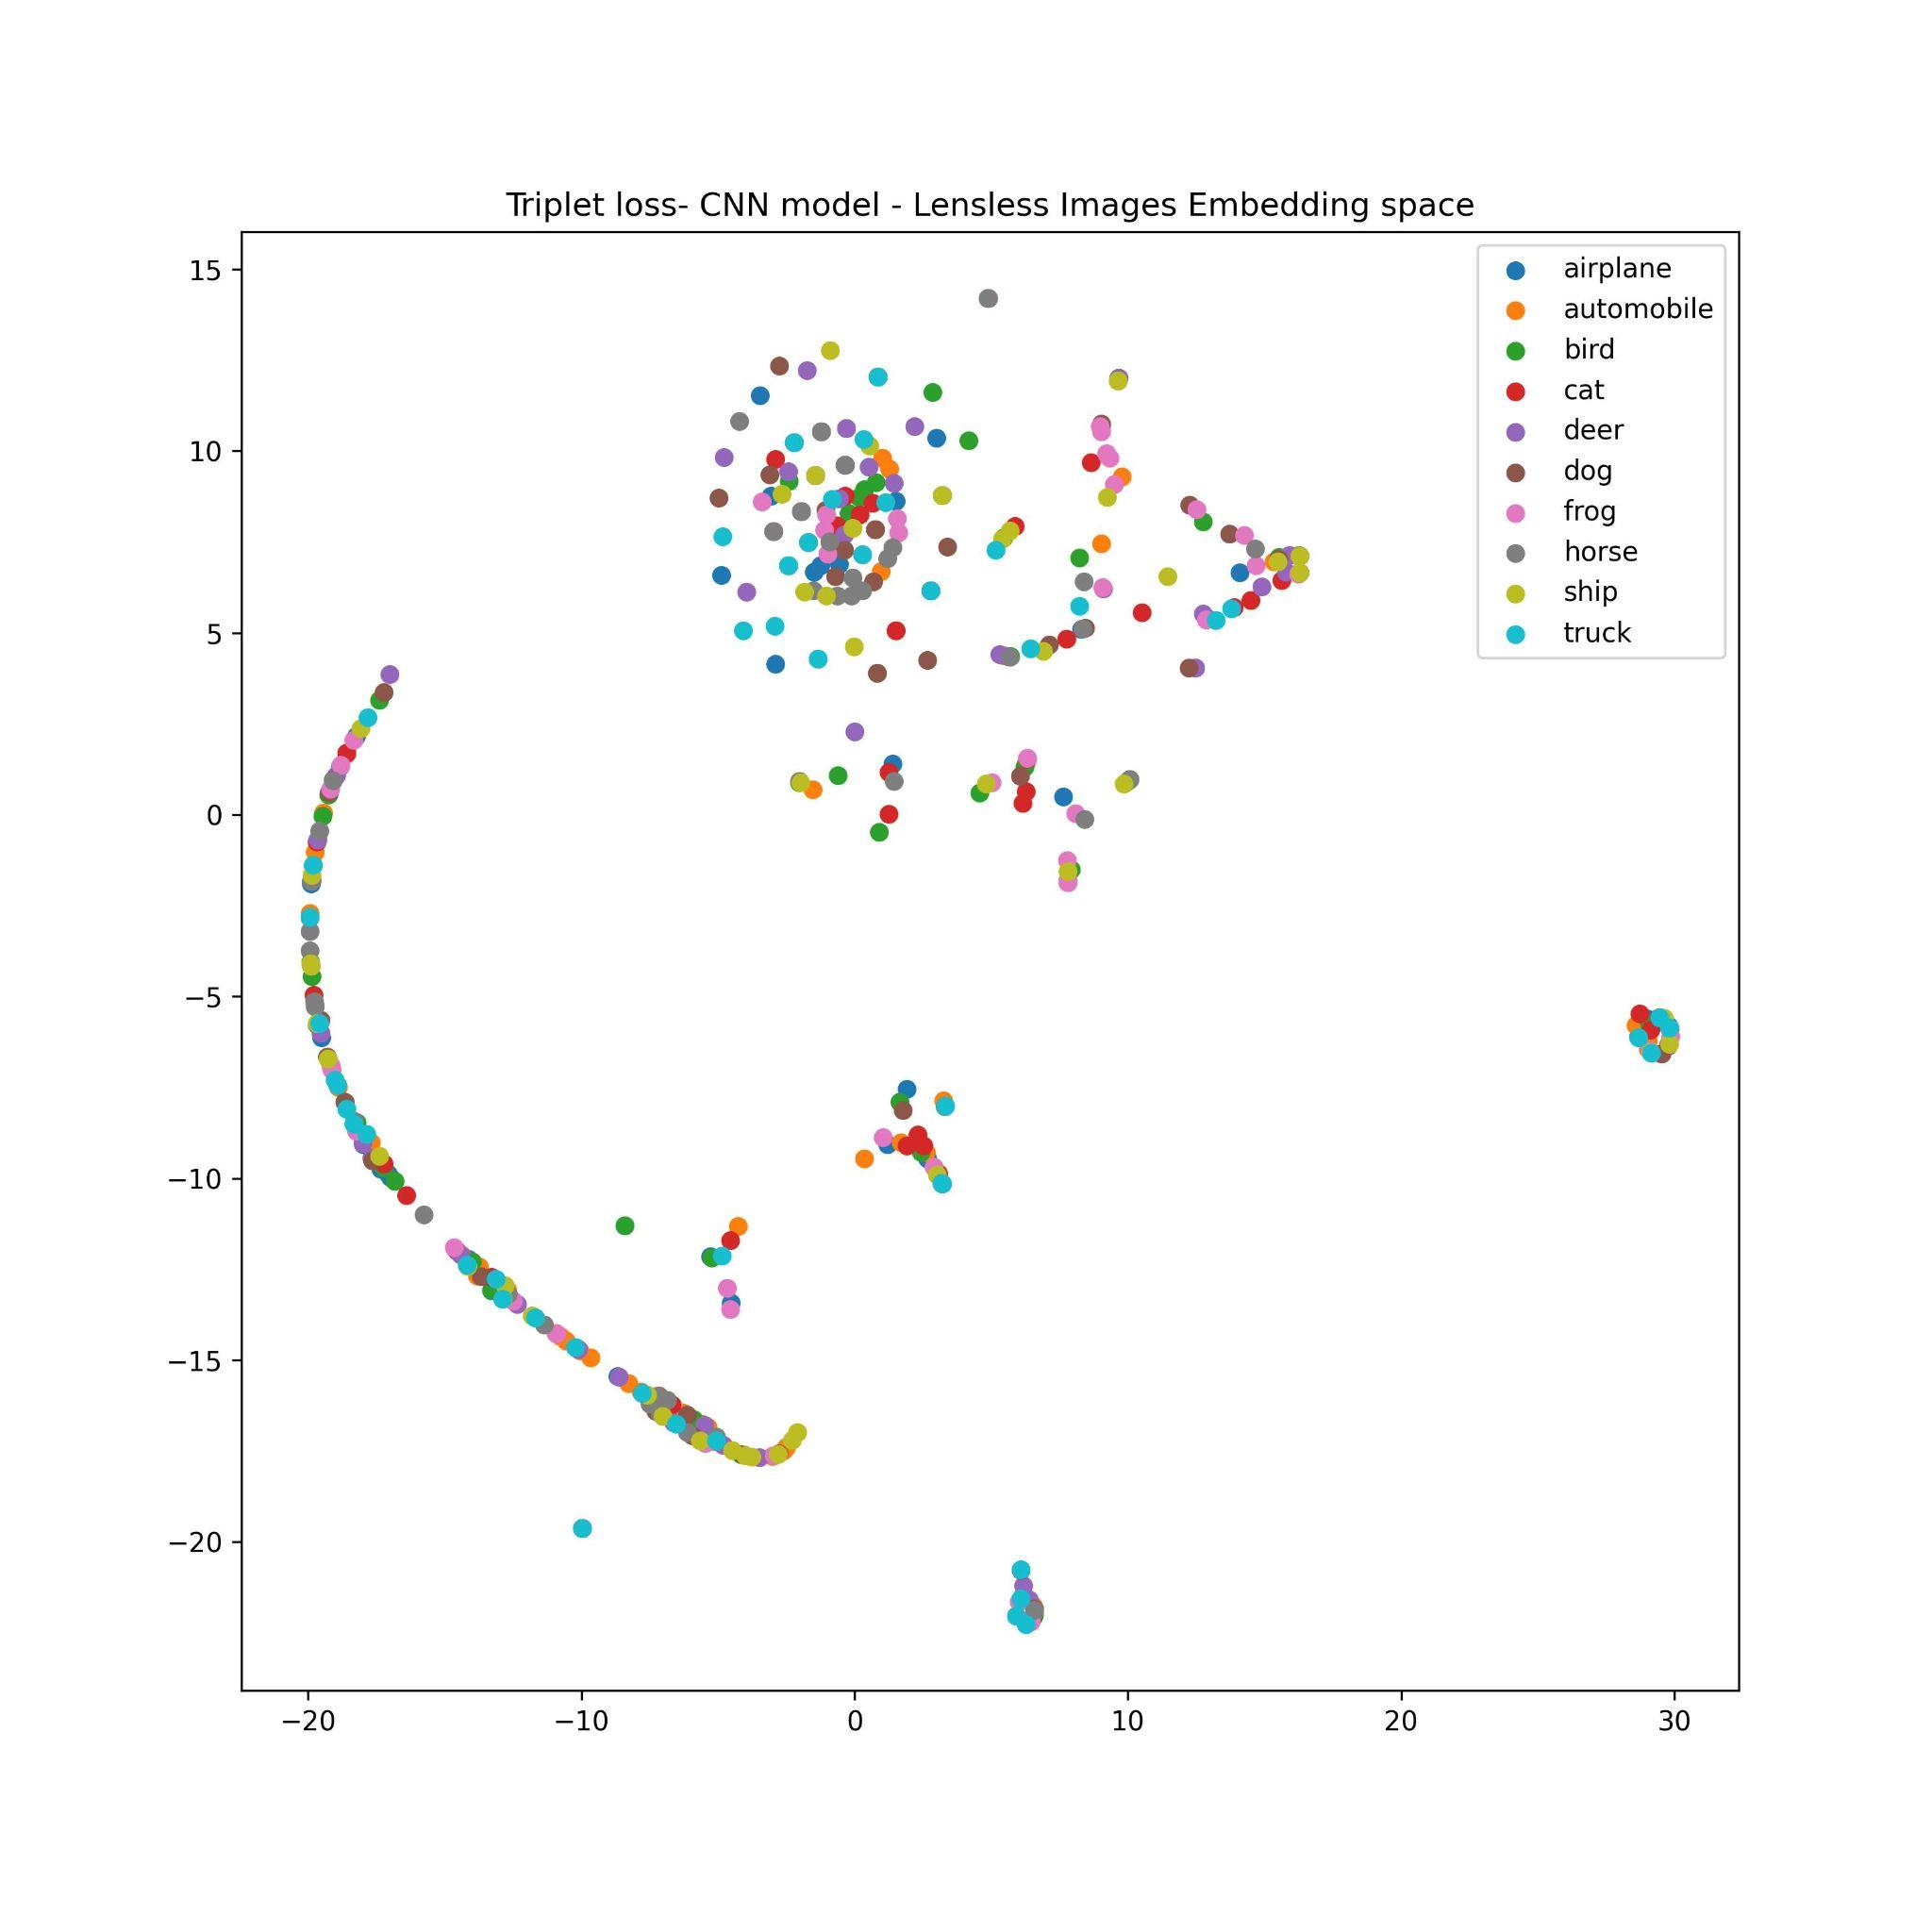
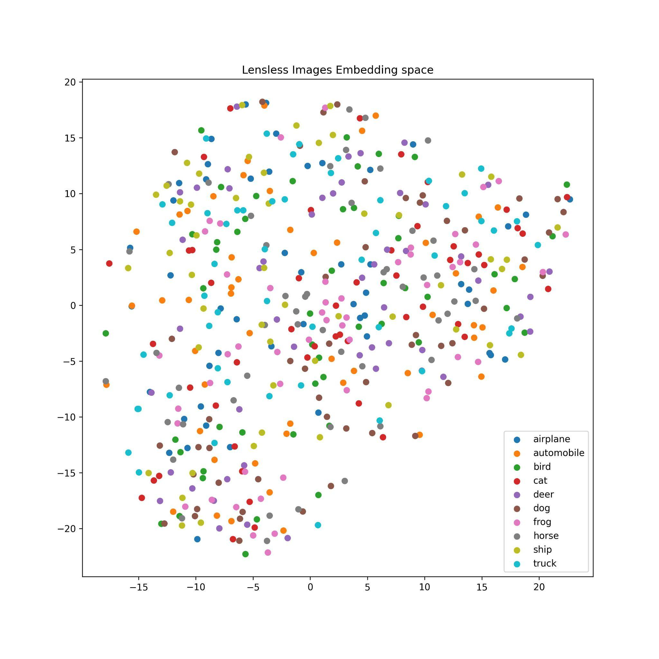
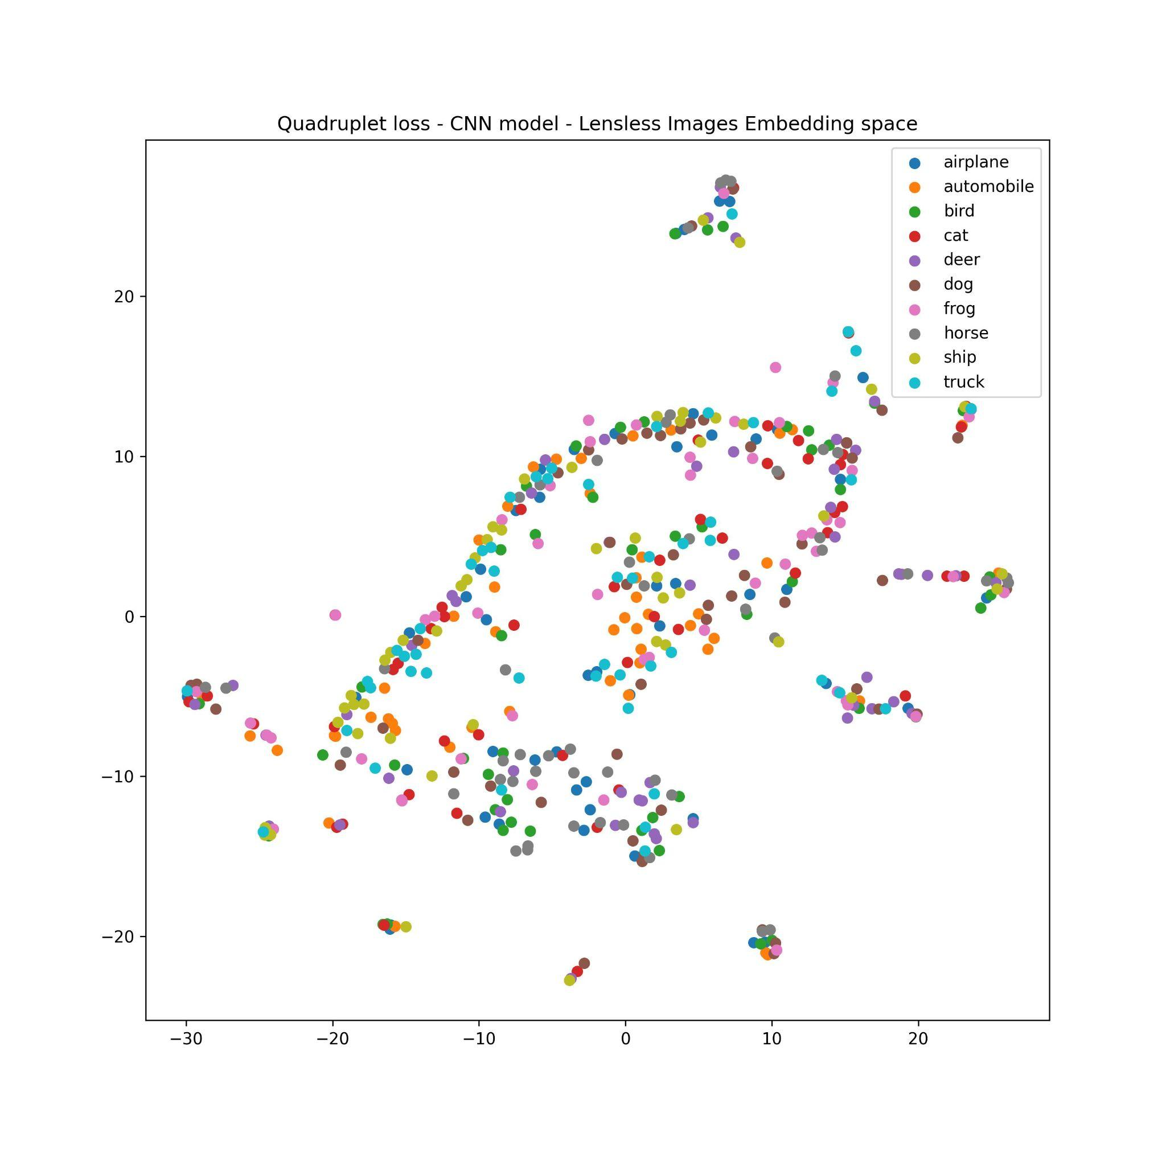
Threshold for lensless images

Slide 19
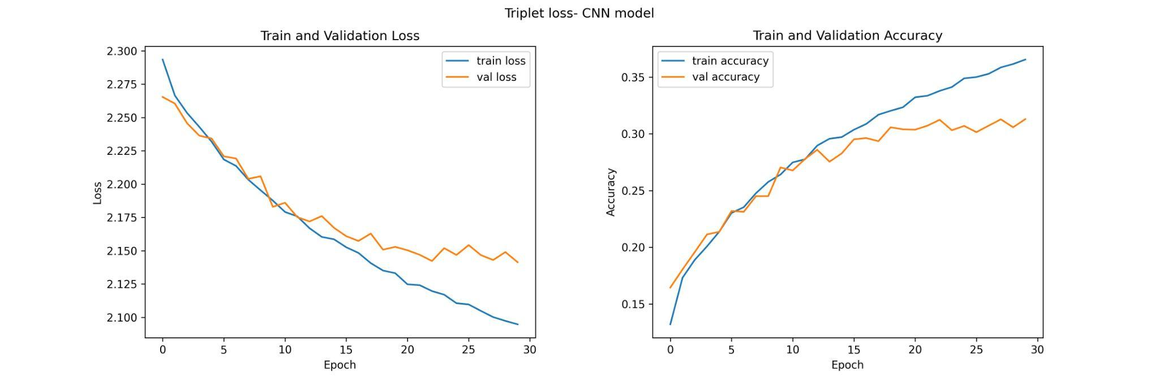
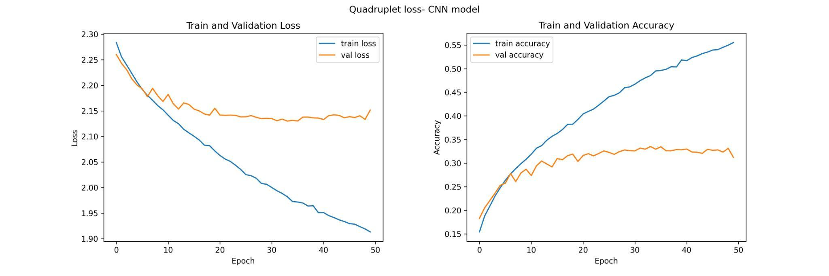
Results
Lensless images

Slide 20
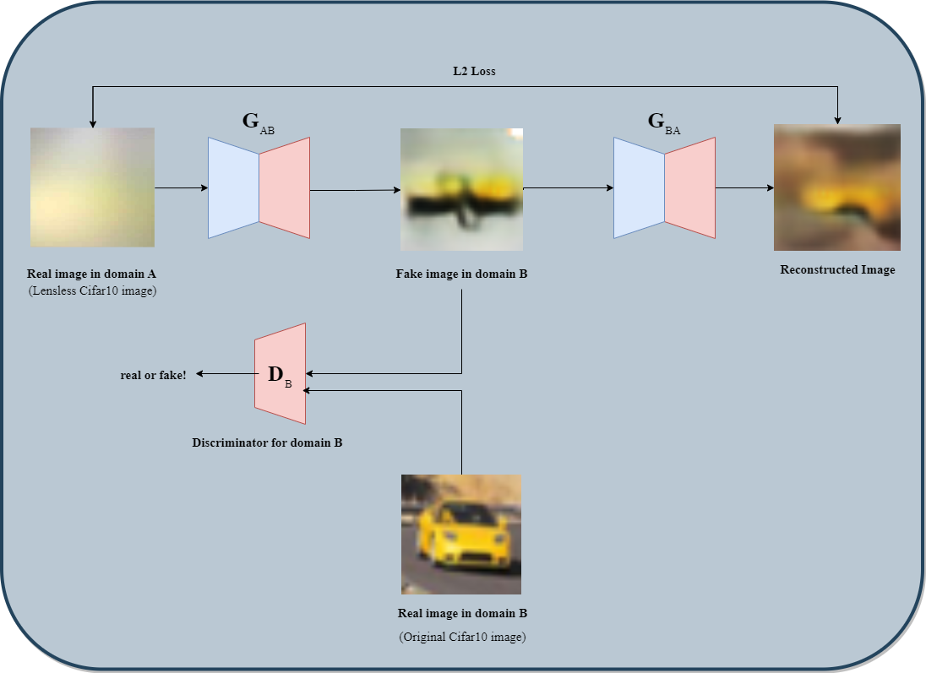
How to improve?
Reconstructive images using CycleGAN
S. Nelson and R. Menon, "Bijective-constrained cycle-consistent deep learning for optics-free imaging and classification," Optica 9, 26-31 (2022).

Slide 21
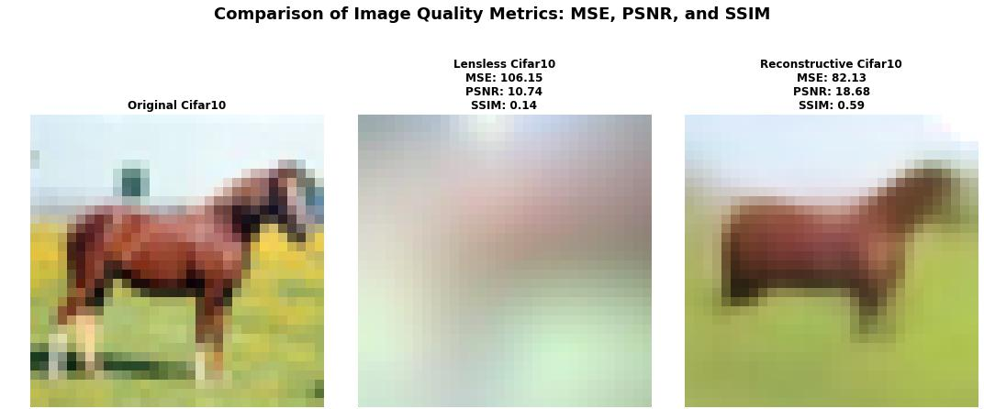

Slide 22
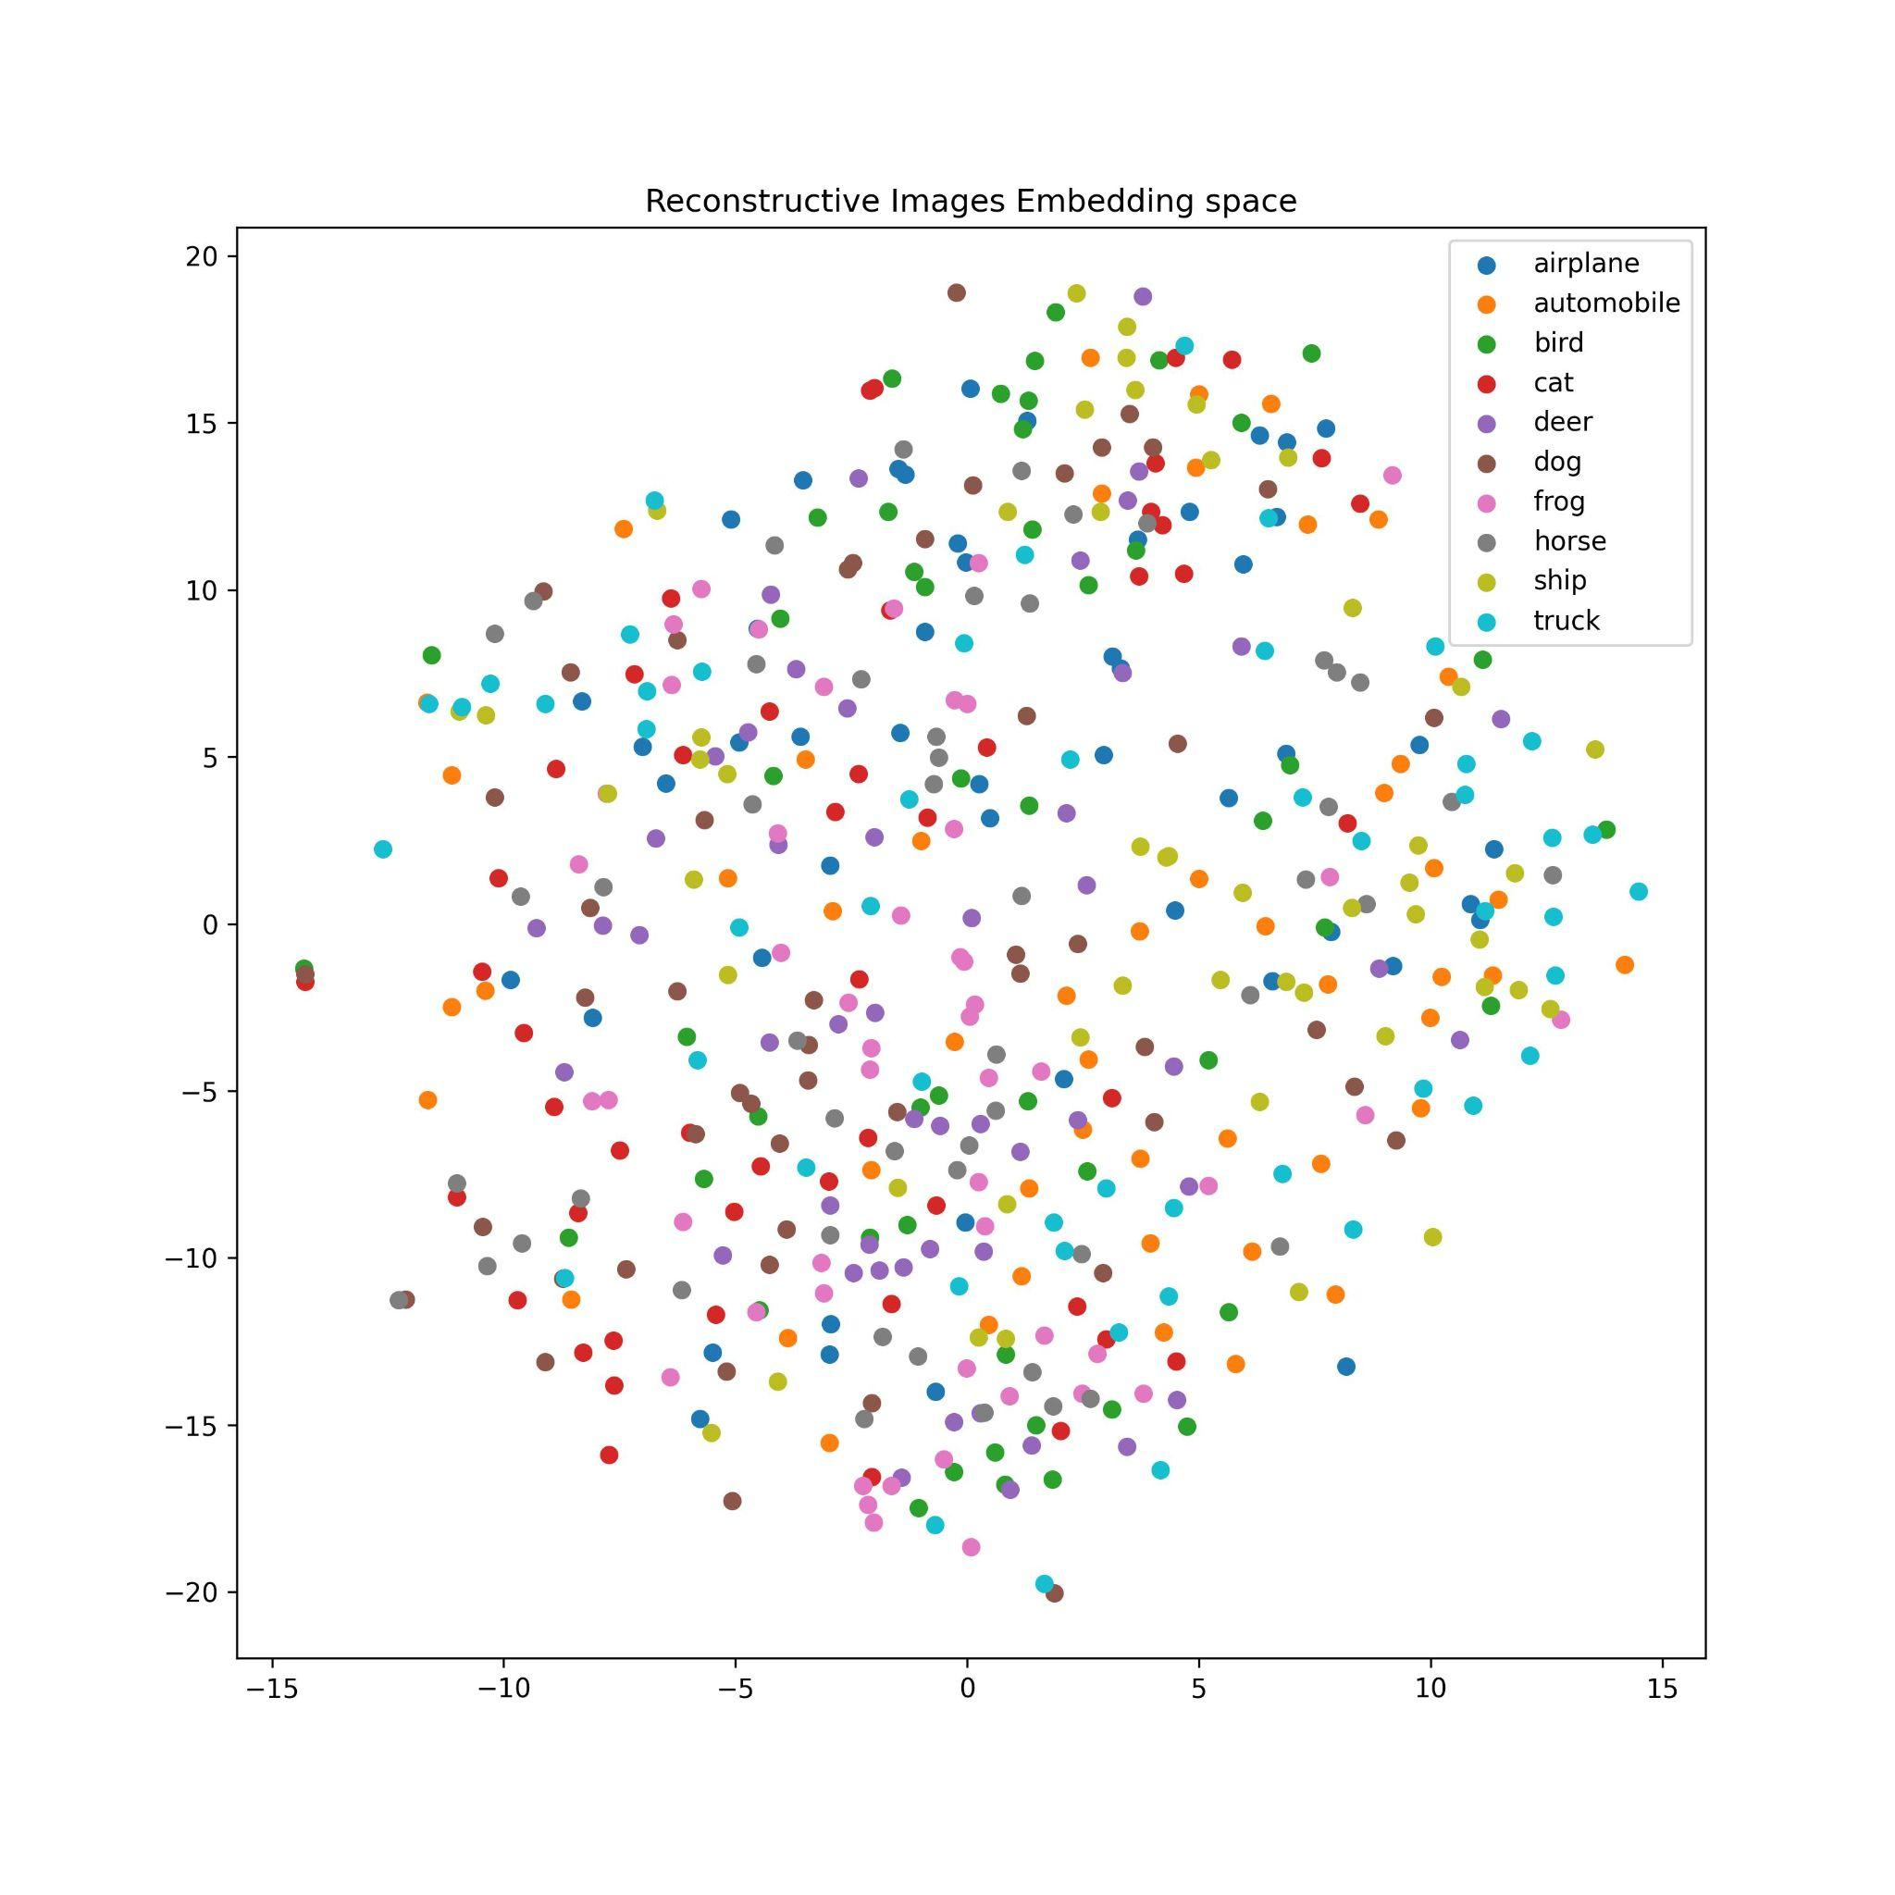
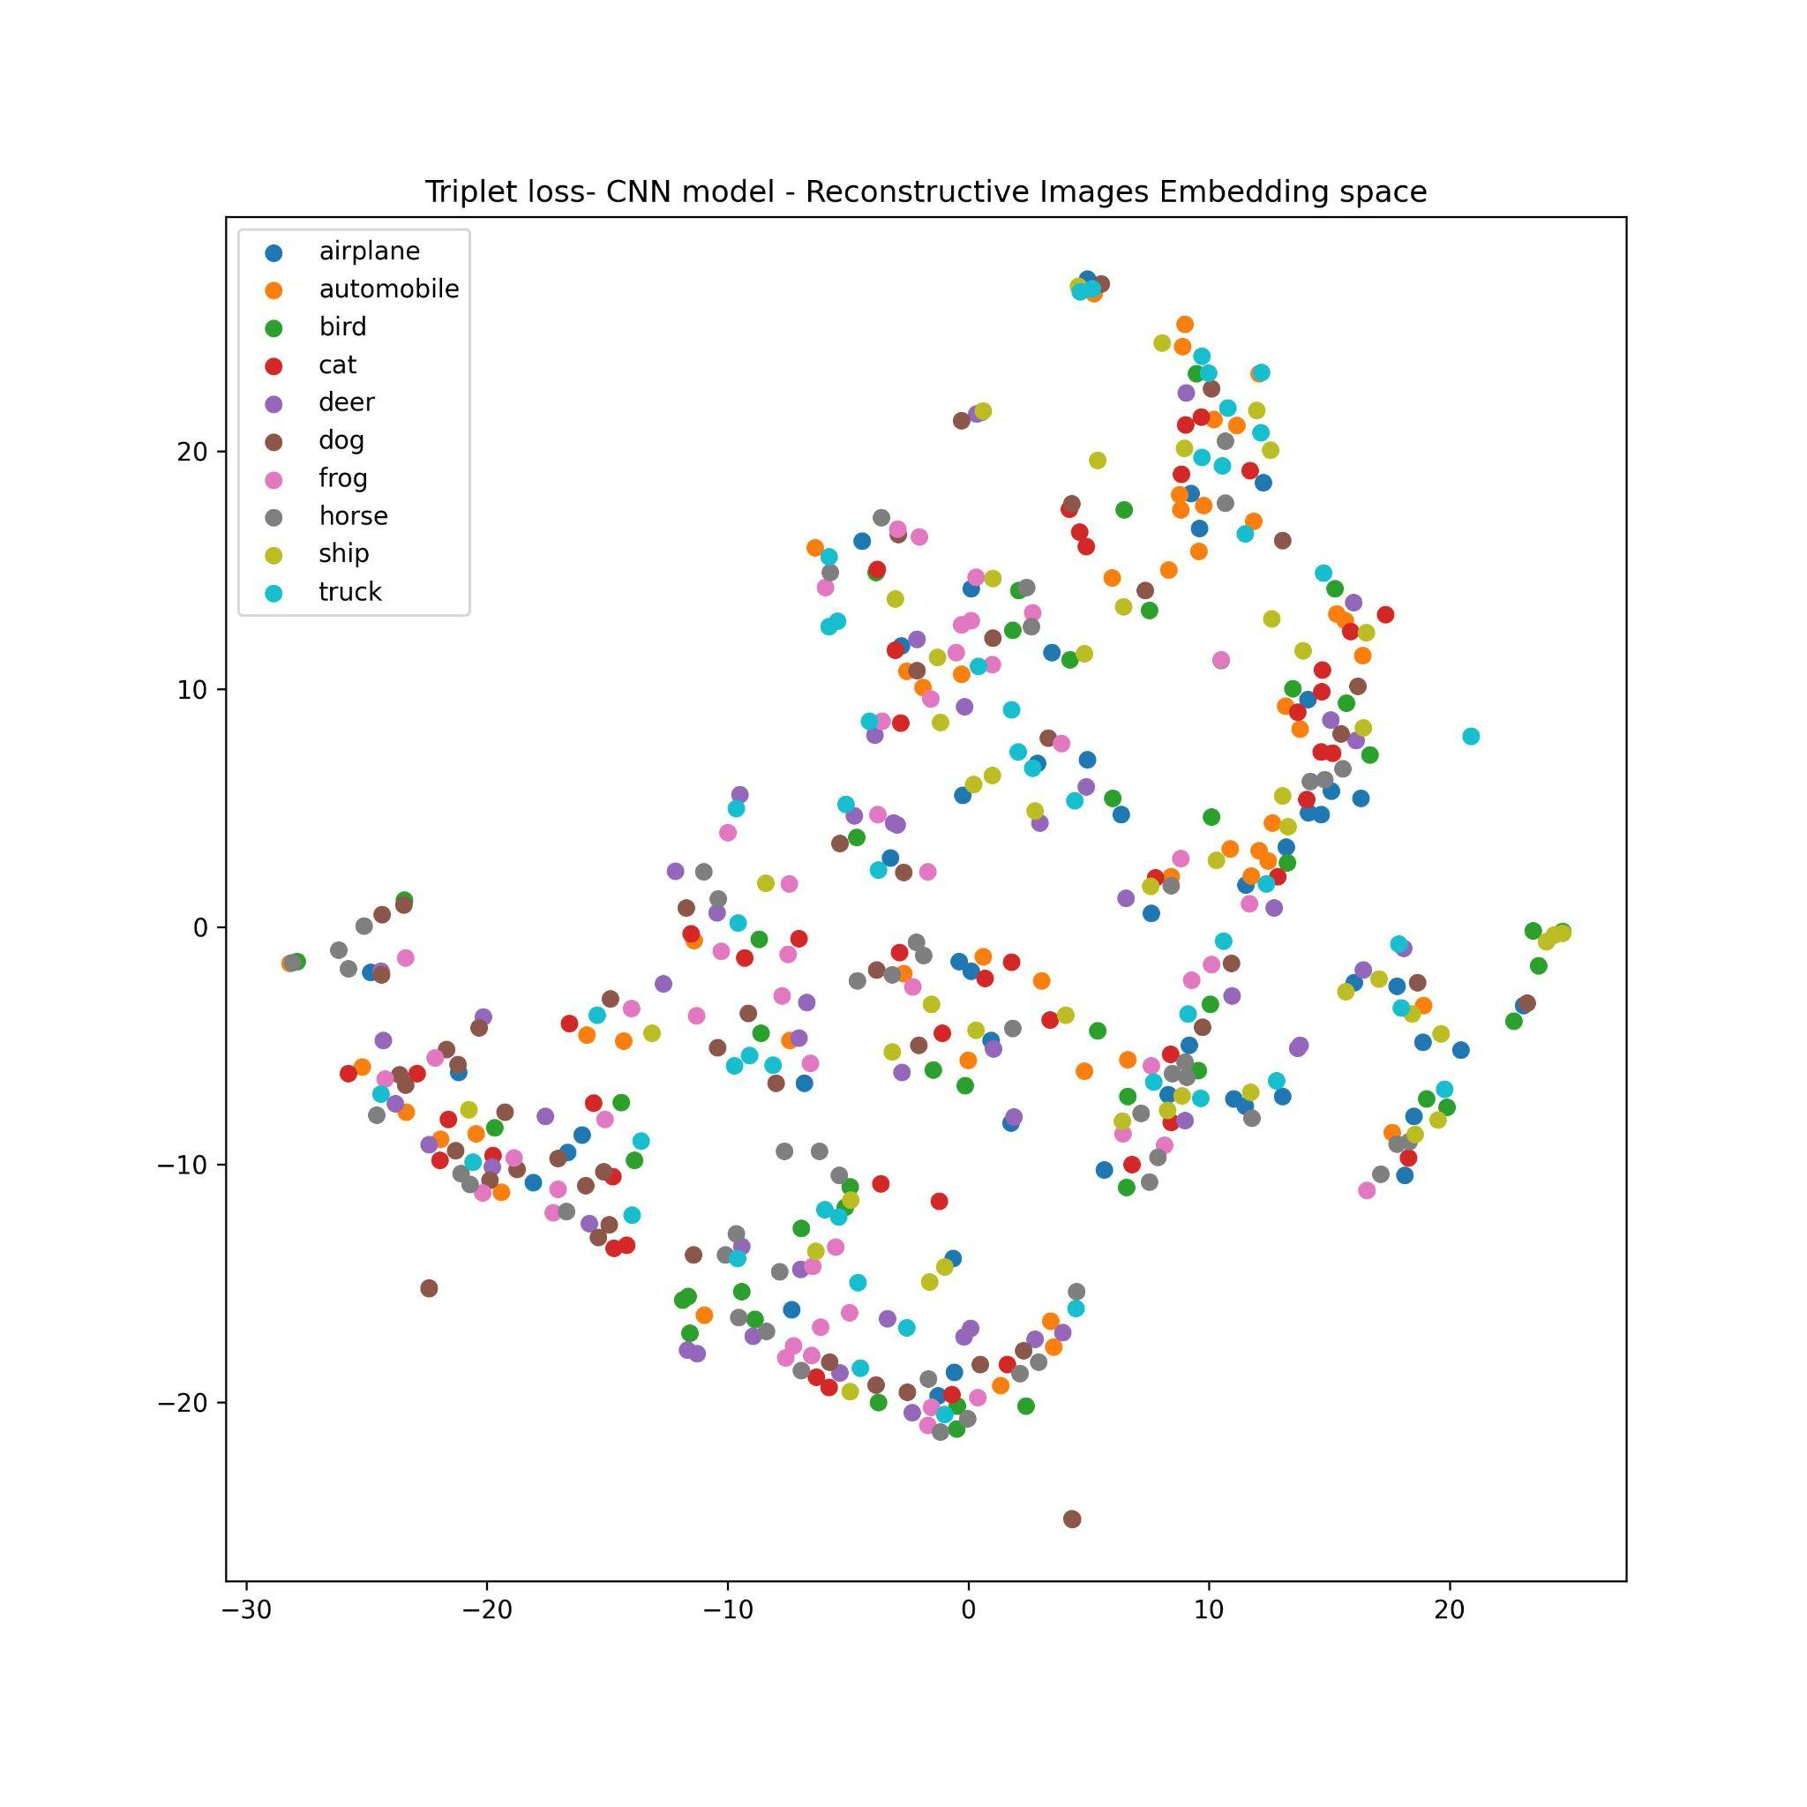
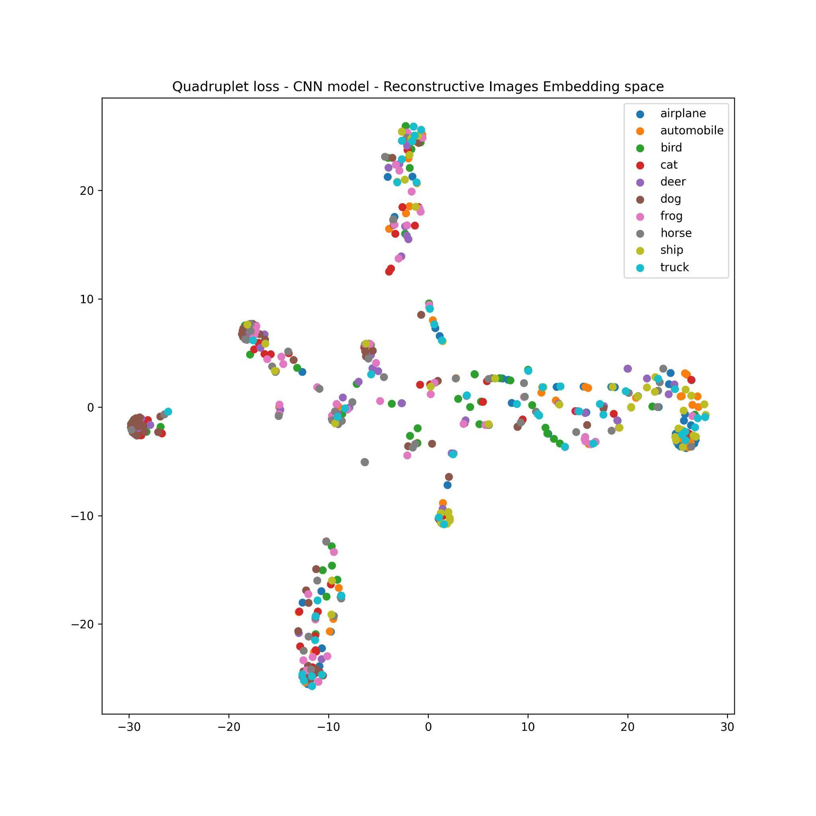
Threshold for reconstructive images

Slide 23
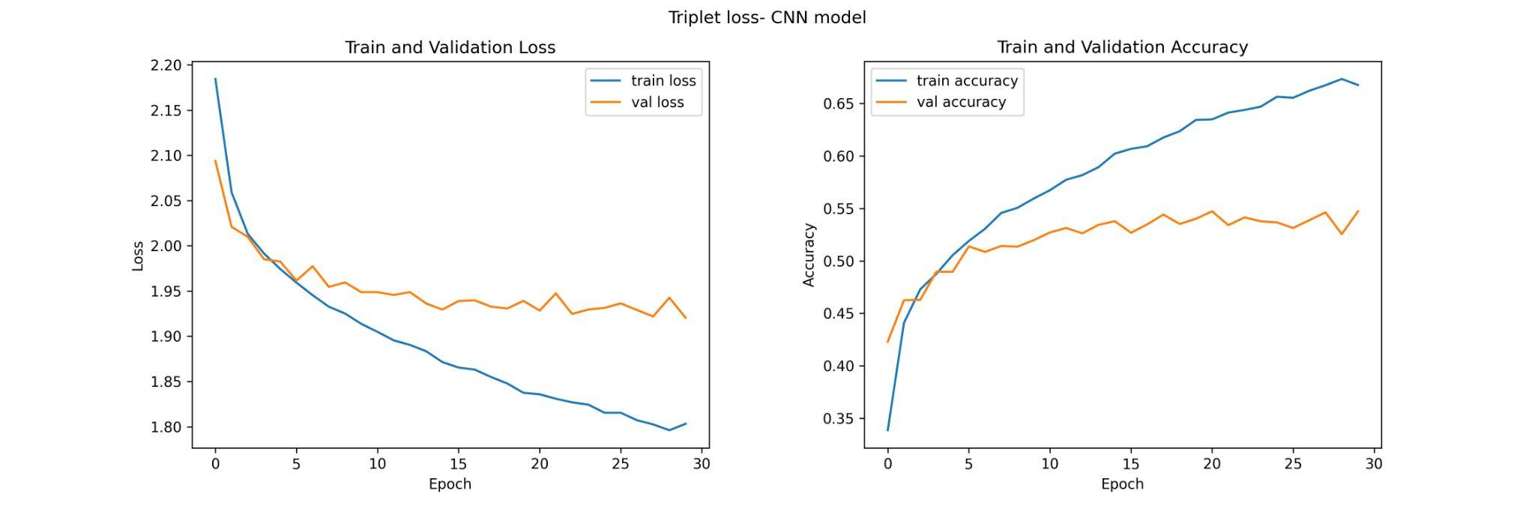
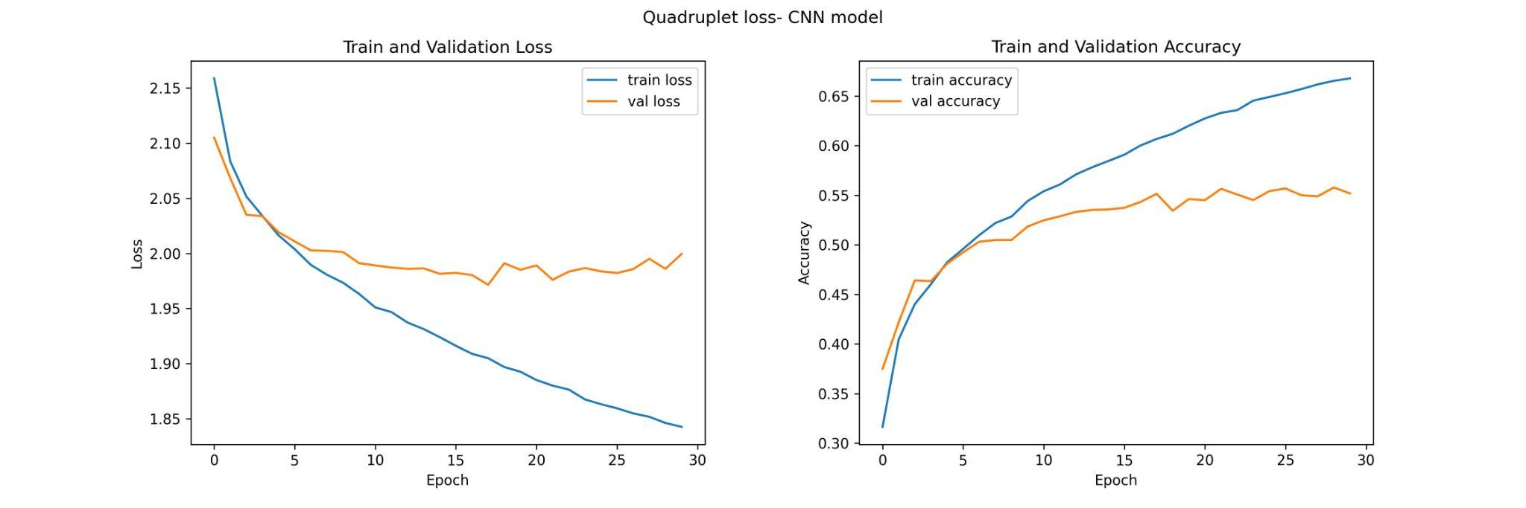
Results
Reconstructive images

Slide 24
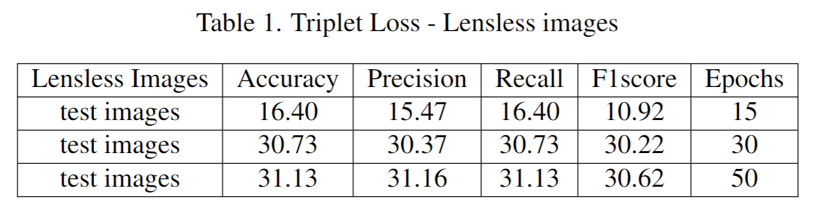
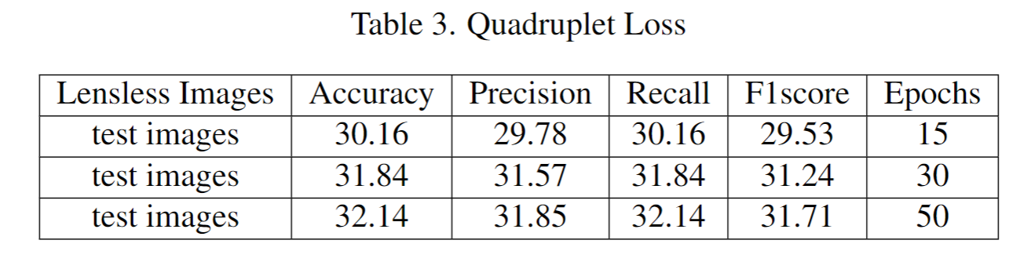
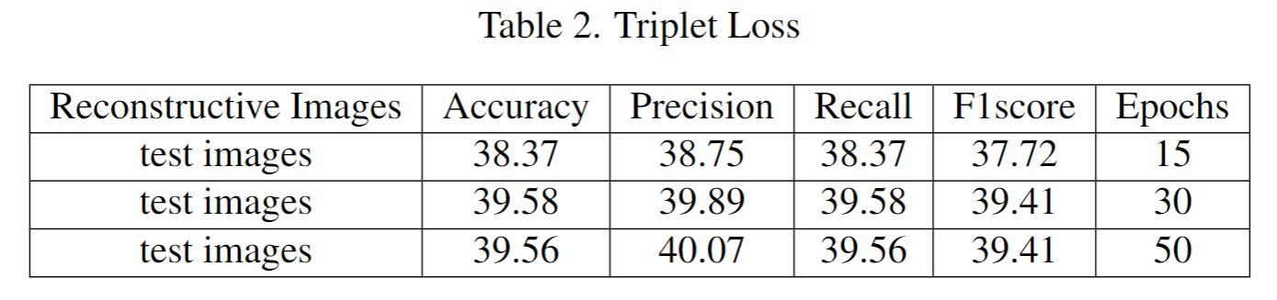
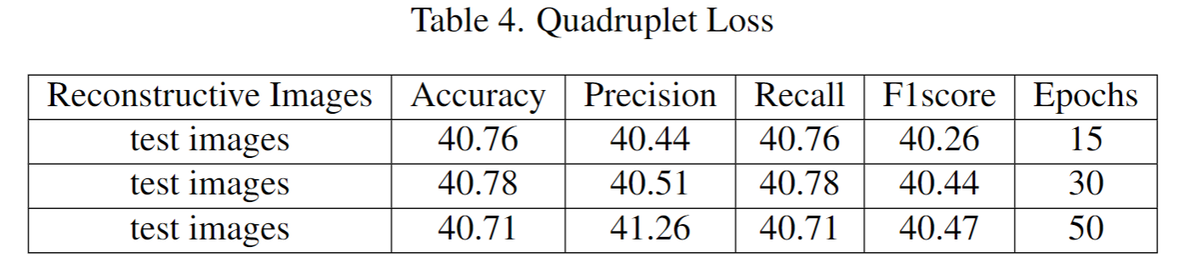
Results

Slide 25
Bayesian Method
Prior - initial belief or assumption
Likelihood - prediction of the CNN
Posterior – updated belief
Notes:
Our thesis work employs Bayesian inference\cite{r19}, a statistical technique that updates the parameter of data generation of noisy optics-free images. We use a uniform distribution occurring in each class with 10 percent chance as a prior. We then use Bayes' theorem to combine the prior and likelihood probabilities to obtain the posterior probability occurrence of each class. The likelihood is the prediction of the CNN.

Slide 26
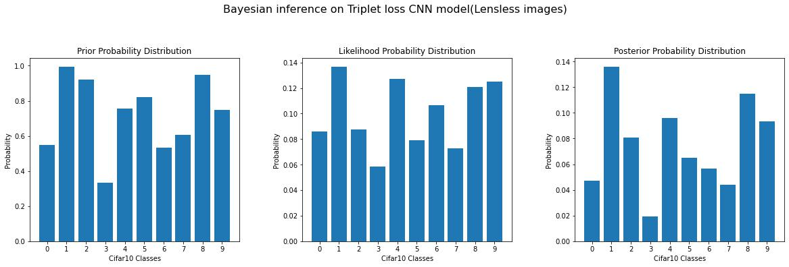
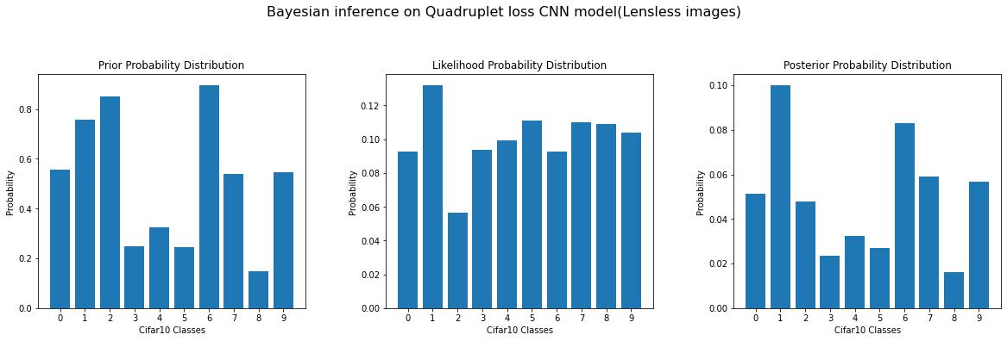
Bayesian for Lensless images
KL Divergence = 0.41 nats
KL Divergence = 0.84 nats
Notes:
The implementation of Bayesian inference in our thesis work enables us to improve our understanding of the underlying distribution of each class in the CIFAR10 dataset, evaluate the quality of our model's predictions, and make more informed decisions about image classification

Slide 27
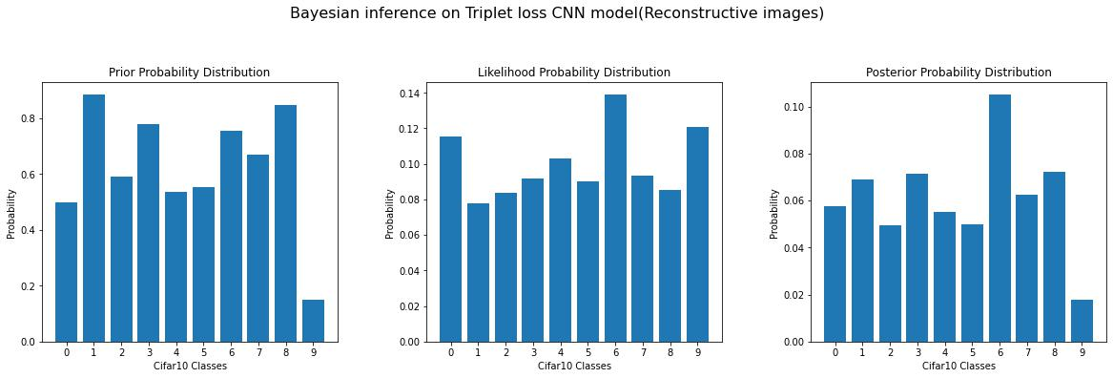
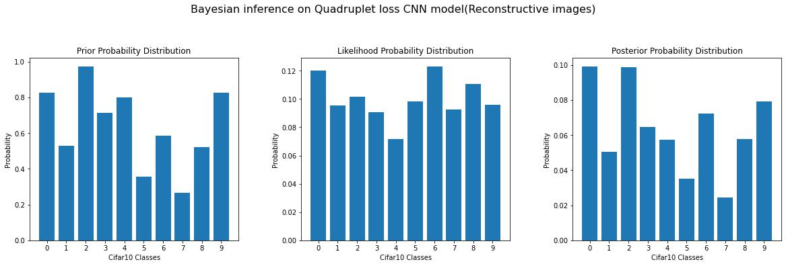
Bayesian for Reconstructive images
KL Divergence = 0.57 nats
KL Divergence = 0.52 nats

Slide 28
Take away points
Potential of making miniaturized cameras
Images are noisy
Some experiments didn’t converge

Slide 29
Future work
Multimodality (text + images)
Planned to use transformer architecture

Slide 30

Thank you!

Slide 31
Reviewer’s questions
How are hyperparameters chosen, does any experiments performed prior, and did any change in the performance of the accuracy in all the experiments?
-By trail and error.
2) What is the Computational complexity of the algorithms?
O(n)
3) How about software services and hardware configuration used in the experiments?
-Google colab, pro
-Hardware: GPU, High-RAM
4) What is the broader conclusion by comparing all the algorithms with a number of epochs considered?
-For lensless, when epochs are increased, accuracy also increases to a certain limit. But for reconstructive, when epochs are increased, accuracy decreases.
Notes:
To calculate the computational complexity of the given neural network model, we need to count the number of operations that are performed during a forward pass through the network.
the computational complexity can depend on several factors such as the number of layers, the number of filters, the size of the input image, and the size of the kernel.

Slide 32
Questions ?

